Slide 1
The Piggy Bank
The banking software you need today

Slide 2
Why choose piggy bank?
Security
Easy usage
Great functionality

Slide 3
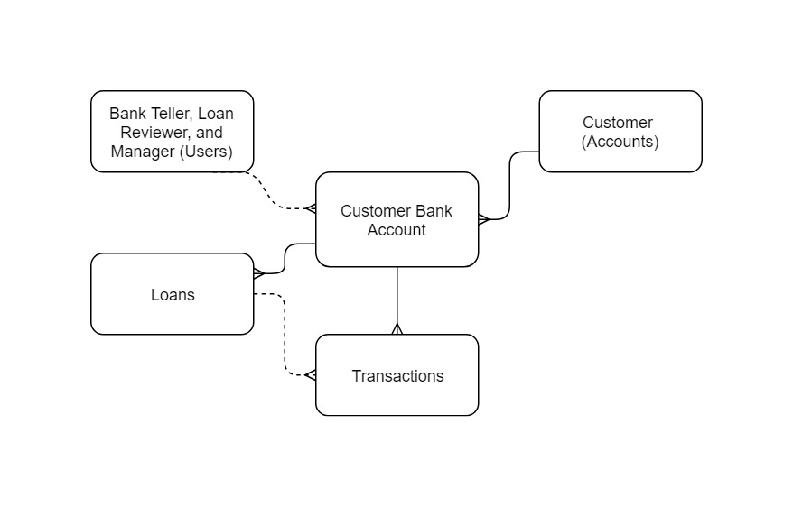
ERD

Slide 4
Customer Bank Accounts
Easy access to create new accounts
Account Owner
Single or Joint

Slide 5
Loans
Create loan requests with ease
Apply amount

Slide 6
Transactions
View all transactions
Withdrawal and Deposits
Approved loans

Slide 7
Org
Problems: User security
Users have a limited inactivity time of 15 minutes
Restricted Login hours
Weekdays 8-5
Saturday 8-2
Sunday 8-1

Slide 8
Object
Users can only access and modify certain objects
Tellers limited to read/write for transaction
Loan Reviewer limited to read/write transaction and loans
Manager has access to Customer accounts, Loans, and transactions

Slide 9
Record
Role hierarchy
PIGGY BANK SOFTWARE
Manager
Bank Teller
Loan Reviewer

Slide 10

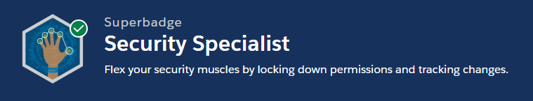
Super badge

Slide 11
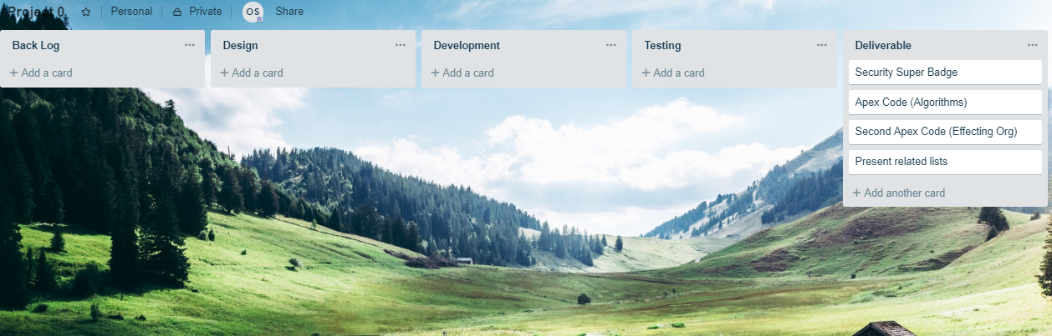

Slide 12
DEMO

Slide 13
Questions?

Slide 14
Thank you

